Slide 1
Posturainer
Team ADC2018111:
Sumedh Naik
Soham Jagtap
Vedali Chaudhari
Sameep Pote
Mentor: Prof. Dayanand Ambavade

Slide 2
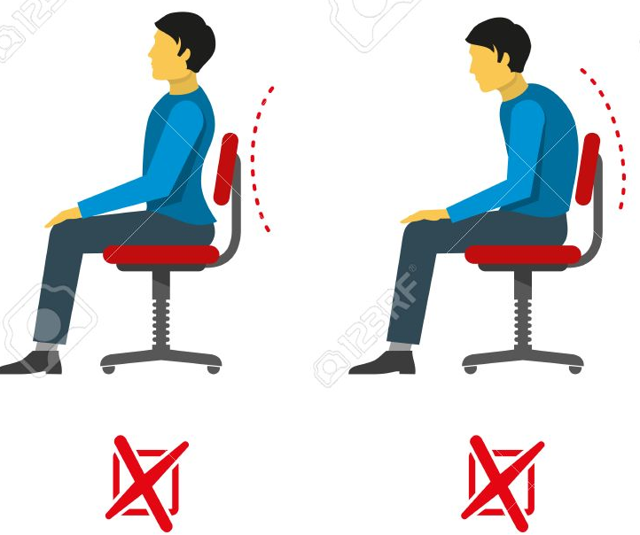
OBJECTIVE
An innovative way to tackle the increasing problem of improper postures.
To condition the muscles eventually leading to a habit of proper posture.
Timely alerts and warnings.
Detailed analysis and performance report.
To ensure healthy sitting habits and a backache-free society.

Slide 3
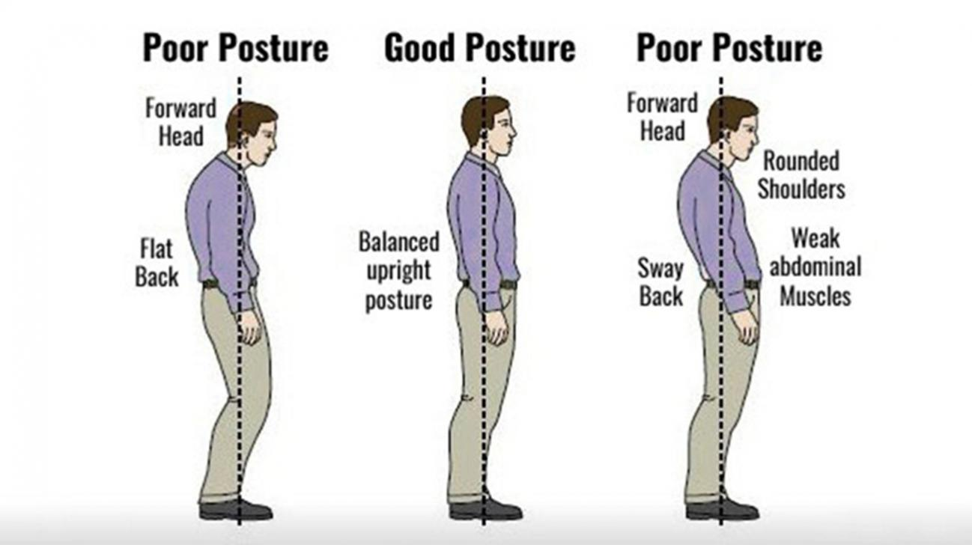
THE NEED
A good stance reflects a proper state of mind.
An upright posture makes you appear more confident, taller and thinner.
Slouching affects the transport of oxygen within the body, resulting in weight gain and fatigue.

Slide 4
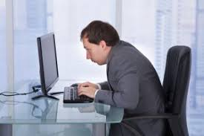
Once the bending of the spine starts, it takes more efforts and pain to attain normalcy.
Sitting for long hours takes a toll on postures and in turn results in backaches.
Inactiveness or over-relaxation leads to a loss in muscle tone, especially in torso, abs and core.
By using Posturainer, you can begin building your muscles in a way that helps you remain upright

Slide 5
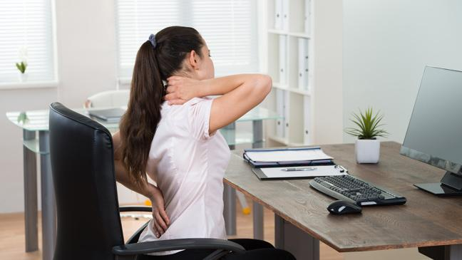
PROBLEM STATEMENT
Posture is often easily neglected.
Necessary to train an individual to practice proper posture habits right from the formative years.
People opt for costlier alternate medicines and chiropractors.
Maintaining proper posture habits is the need of the hour.

Slide 6
STAKEHOLDER VALIDATION
Unlike any other product in the market.
Our customers include people across all ages and across all professions.
Aim is to have a widespread reach.
Partnerships with doctors will help in customer connect.
A survey of people was undertaken and the product was validated by the doctor.

Slide 7

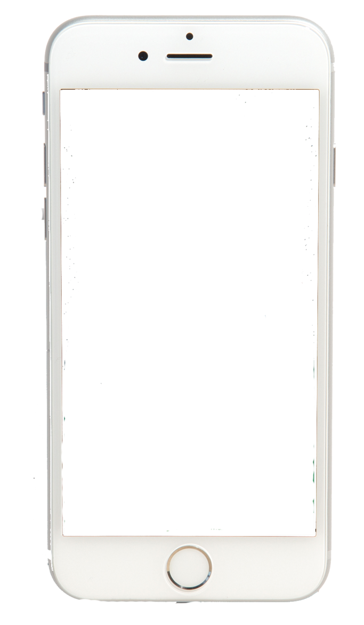
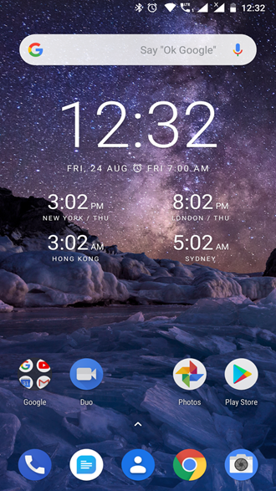
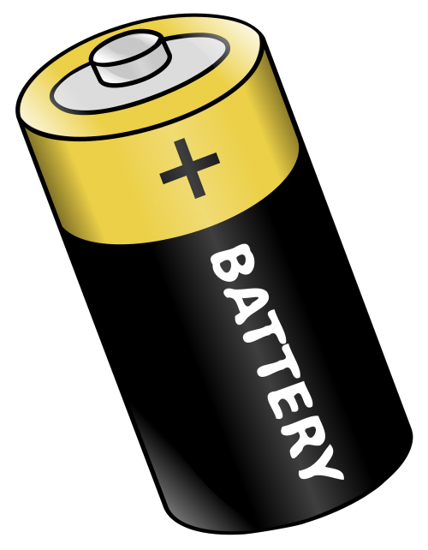
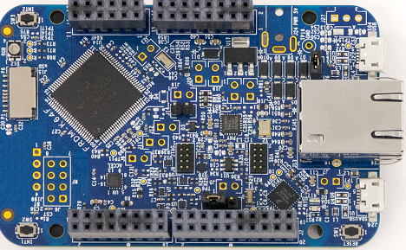
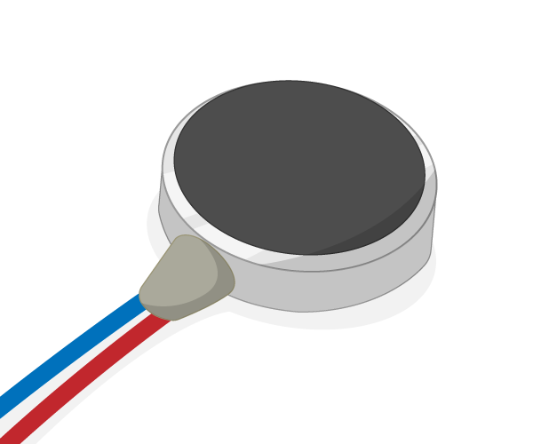
Engineering Details
1) Architecture:
Magnetometer calculates reference values and works accordingly tracking posture changes.
Mobile Application
Monitoring through App
Vibration Motor
FRDM - K64F
Warnings through vibration
‹#›

Slide 8
Engineering Details
2) Hardware:
The FRDM-K64F consists of an inbuilt Accelerometer and Gyroscope that is used to measure both initial reference and the corresponding changes when in use.
When Posturainer is in calibration mode, the reference values are recorded by the FRDM-controller.
Whenever there is a change in the posture beyond a certain level, the device starts vibrating. These warnings can also be controlled over time and frequency. They can also be programmed in a smart sense so as to notify the direction of slouching as well. A simple 5V battery source is used for the same.
RESET button and multi-colour LEDs are also used for indications and user assistance.

Slide 9
Engineering Details
3) Software:
There are two parts in Software: A)ARMS Control System B)Mobile App
The ARMS Control System is coded using mbed. It contains the basic mbed and accelerometer libraries and connects the mobile application using the bluetooth module.The processor stores the initial values of accelerometer and compares with the current values. If there is a considerable change it gives feedback through the vibrational motors
The mobile application is made using Android Studio and MIT App Inventor.
It connects to the ARMS processor using bluetooth protocols and enables a serial communication between the user and the device.

Slide 10
Implementation
Issues Faced: Main issue faced while implementation was Multiple Serial Communication at the same time. As we were using Accelerometer and Bluetooth module at the same time and both uses TX and RX for serial communication the signals sent by the sensors were getting interfered by each other
Solution: It was resolved by changing the type of communication. The accelerometer used SDA pin to send data to the processor while the Bluetooth module continued using TX and RX for Serial Communication
Learning: a)Coding ARMS Processor using mbed
b)Android Application Development

Slide 11
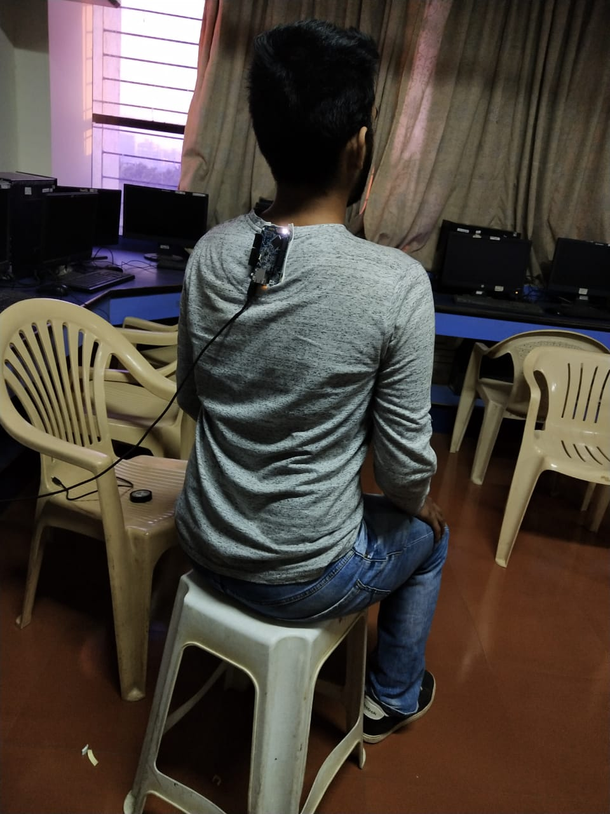
VALIDATION
Once calibrated, it considers that base position as reference.
Deviation beyond a threshold will lead to a vibration.
It continues until the person returns to a safe posture.
The device was tried on a person and the results were shown in the video sent during the previous round.

Slide 12
SUSTAINABILITY
Employs a low power sensor and motor circuit, thus making it economically more viable.
With an expected boom in the silicon industry in India, Posturainer has a promising future.
The working can be carried out smoothly irrespective of user’s age due to the real-time calibration of the device.
With higher business prospects and a stronger sustainability, Posturainer will certainly attract capital investments.
Easy installation and error free working will serve as a great help to the society.

Slide 13
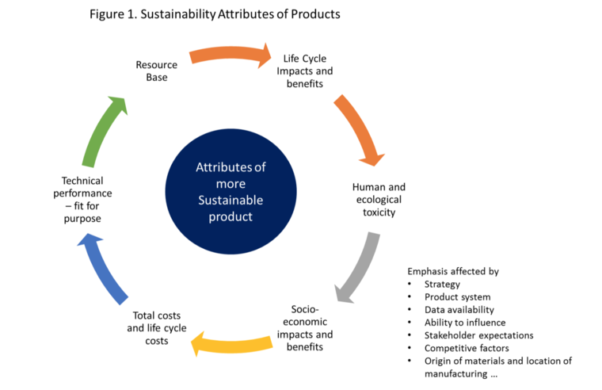
Long life and high economic feasibility
Limited resources used
Corrects and trains your Body posture
Independent of environmental changes, human errors.
Affordable and easy to use
Reduces risk of back related diseases

Slide 14
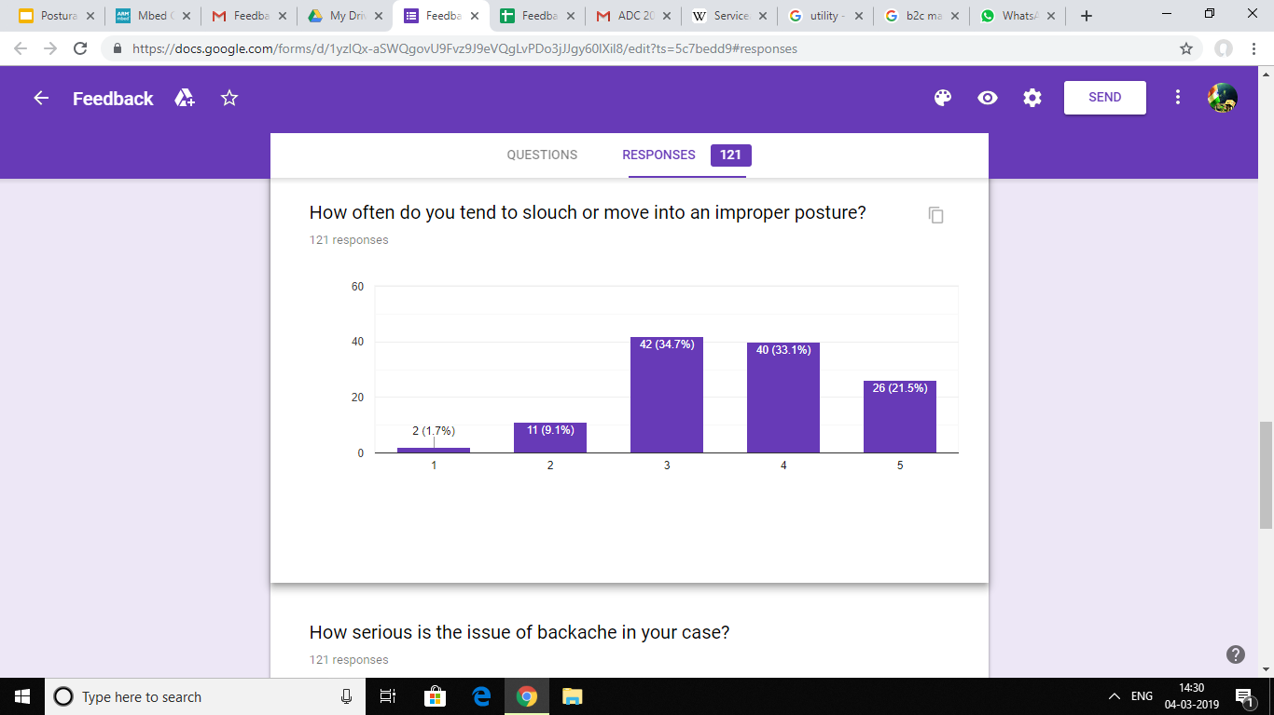
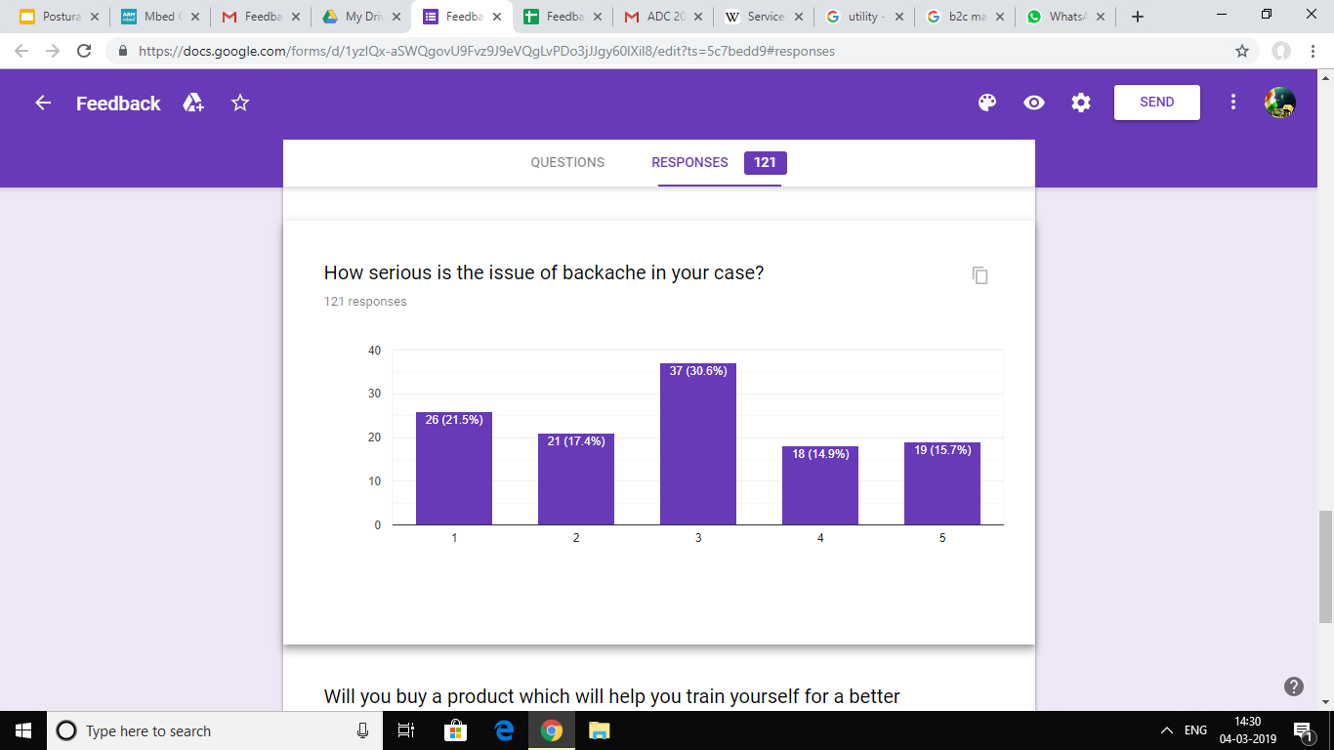
SOCIAL IMPACT
Posture correction will address the issues related to the back.
Train people to maintain correct postures
Increases their self-esteem and makes them feel assertive.
Aims at improving the health of the society and creating a healthy corporate and domestic workspace.

Slide 15
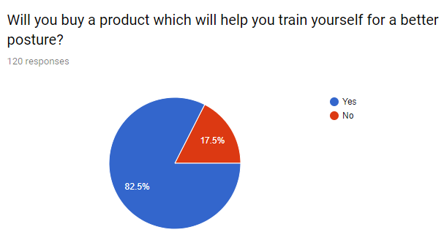
SCALABILITY
A recent study shows that more than 80% of the people across all age groups are willing to buy the product.
The product has its applications in all domains and can be effectively marketed to attain a wide growth. Here are a few channels which will be used for the same:
Medical practitioners and orthopedic surgeons.
B2C marketing.
Online Branding and sales.
Programming and software companies.
Educational Institutions.
Search Engine Optimization (SEO).
Social Media Branding and AdSense.
Notes:
Serviceable addressable market

Slide 16
WHAT NEXT ?
Provides a detailed analysis of the training period.
Machine Learning can also be employed to design training programs for the user.
Training programs with an aim at restricting further damage and thus helps them live a stable life ahead.
Customizing our own boards with an inbuilt battery source will reduce bulkiness as well as cost, thus making it more compact
Mobile Application
Compatible for all
More Compact

